Slide 1
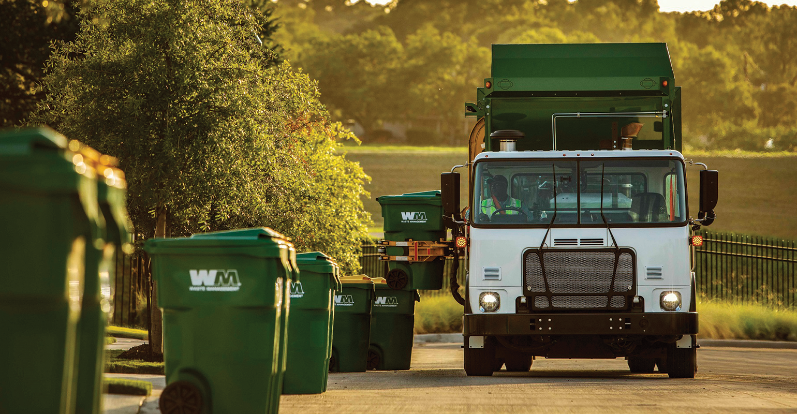
Waste Management in
Smart Cities
By
Rahana Joshy
Roll No – 29
MCA S4 B

Slide 2
contents
Introduction
Objective
Needs of waste management
Existing System
Proposed System
Main Roles
Software specifications
Screeshots of UI
References

Slide 3
Introduction
Smart cities have the potential to overcome environmental problems caused by improper waste disposal by improving human health, protecting the aquatic ecosystem, and reducing air pollution. However, today’s systems, approaches, and technologies leveraged for waste management are manual and centralized.
This fact makes them vulnerable to single point of failure problem. Also, a large portion of the existing waste management systems within smart cities fall short in providing operational transparency, traceability, audit, security, and trusted data provenance features.
In this project, we are going to create a system in managing waste within smart cities as it is in a decentralized, trusted, and secure manner.

Slide 4
objective
The key point in waste management for smart cities is that municipalities that are responsible for waste management in cities have various needs, and latest technologies present efficient and proper waste management solutions for sustainable municipal waste management.
That’s why this project provides with some of the needs and efficient solutions for municipal waste management.

Slide 5
Needs of waste management system
One of the need of municipalities is that municipalities have waste trucks and drivers of that waste trucks. The municipalities need to view and control that their waste trucks proceed in the most efficient route possible.
Another need of municipalities in waste management is that they need to cooperate with their citizens in waste management processes.
The responsive person of the waste management in a municipality needs to control waste management processes from a practical point of view. So, all-in-one technology will be very beneficial for the municipalities.

Slide 6
Existing System
Manual
Not efficient
Single point of failure problem
Inefficient deployment of the Vehicle & Workers

Slide 7
Proposed System
Digitalised
Monitoring of drivers and other workers.
Helps the authorities with the single monitoring dashboard
Detailed analysis reports in Web Application
Efficient

Slide 8
MAIN ROLES
Municipality Employee (Admin)
Registration
Login
View notifications
Manage users (Customer, Inspector, contractor, Driver)
View payments and customer requests and their contractor details
Assign inspectors to location
Send replies to the complaints
View work status
Customer
Login
Sent waste collection request
Make payment
View accepted requests
Add complaint
Track Driver

Slide 9
Inspector
Login
Receive request notification from Admin
Approve request
Contractor
Login
View and accept request
Add/View driver
Assign driver
Track driver
View Report
Driver
Login
View assigned tasks
Update status of task
Factory
Login
Sent waste collection request
Make payment
View accepted requests
Add complaint
Track Driver

Slide 10
Hardware Specification
Processor: i5
RAM: 4GB (Minimum)
Hard Disk: 250GB or above
Mouse
Keyboard
Software Specification
Tool: Pycharm, Android Studio
Operating System: Windows 10
Front End: HTML,CSS,JS
Back end: Python, Android,

Slide 11
SCREENSHOTS OF UI

Slide 12
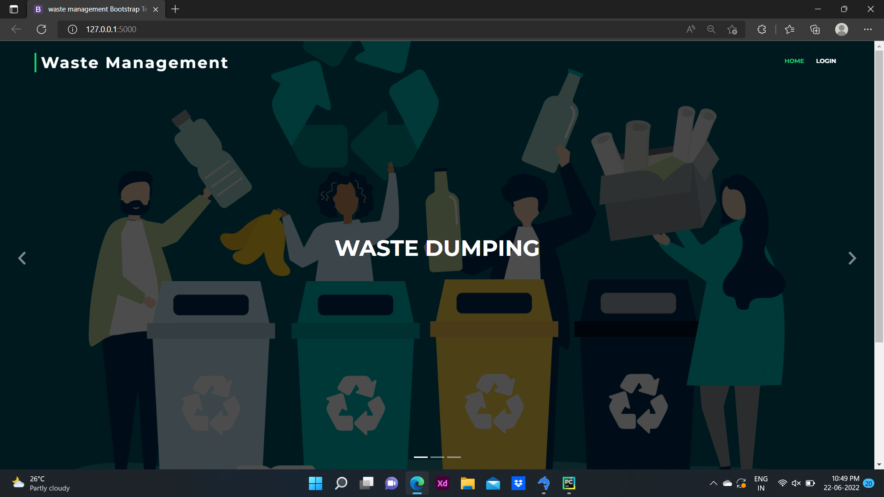

Slide 13
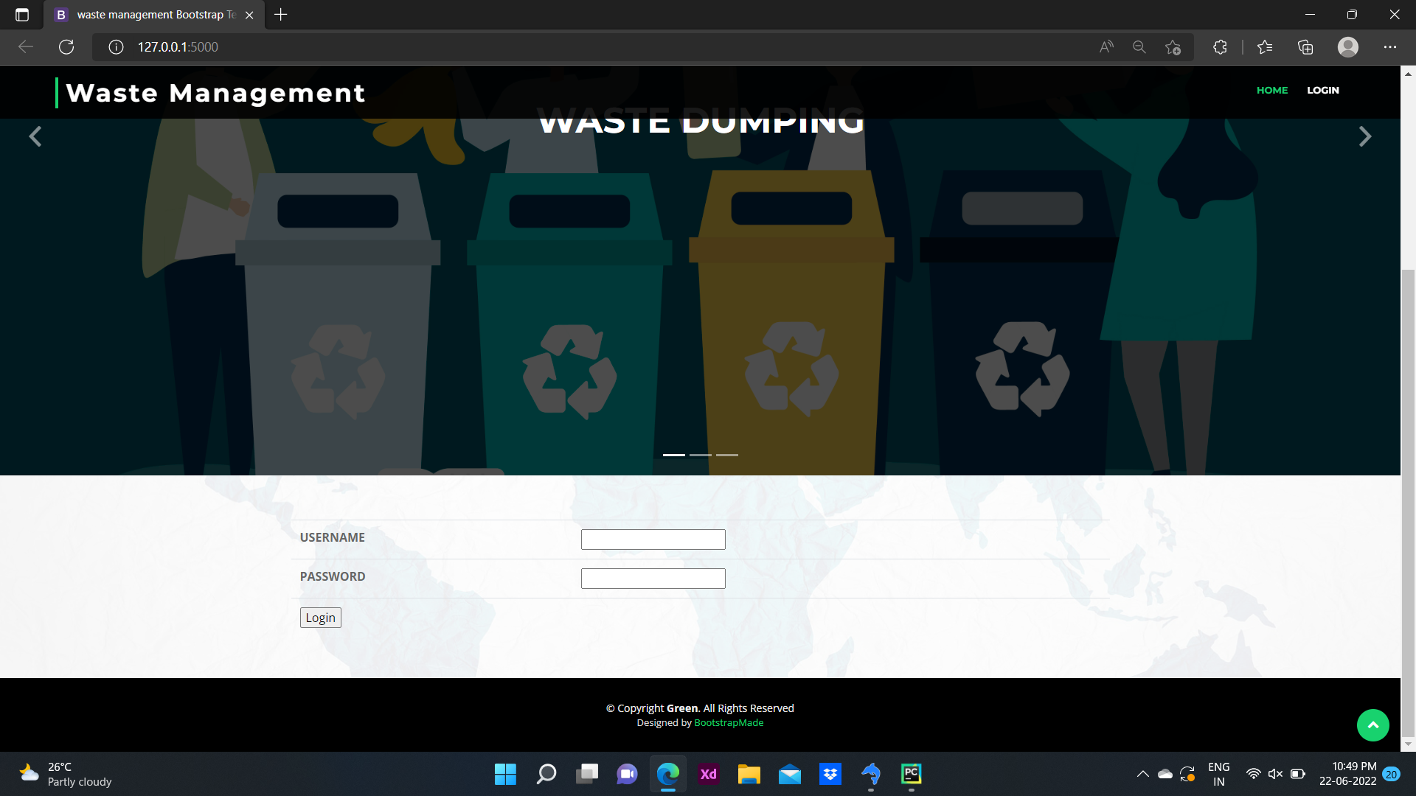

Slide 14
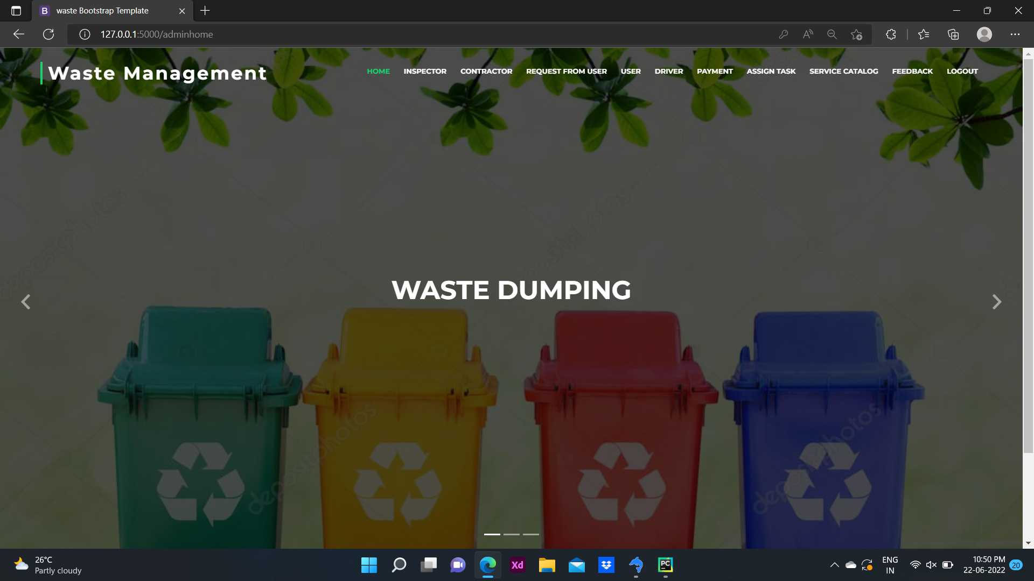

Slide 15
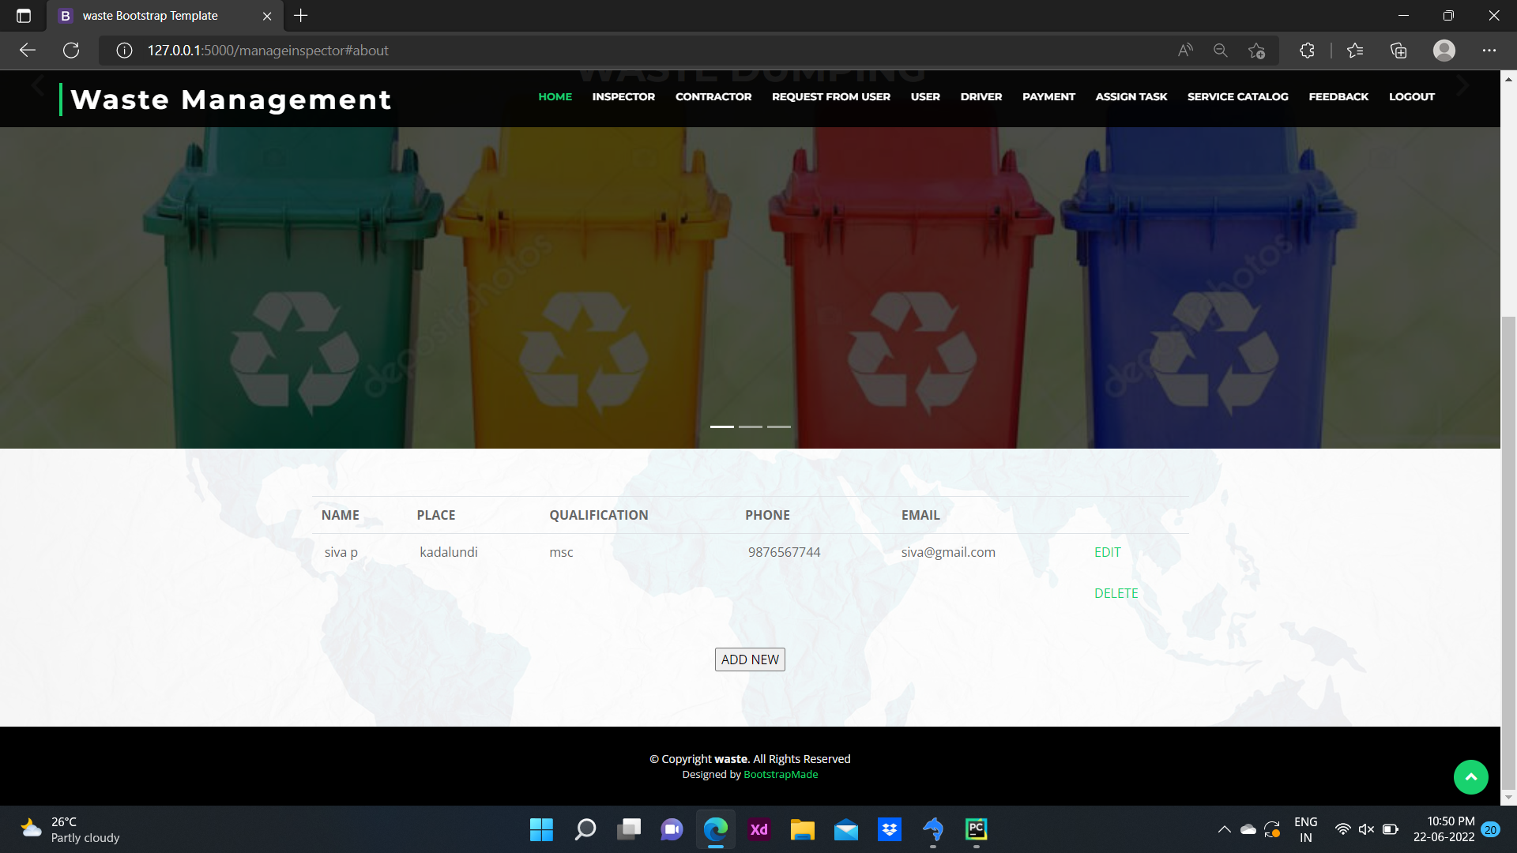

Slide 16
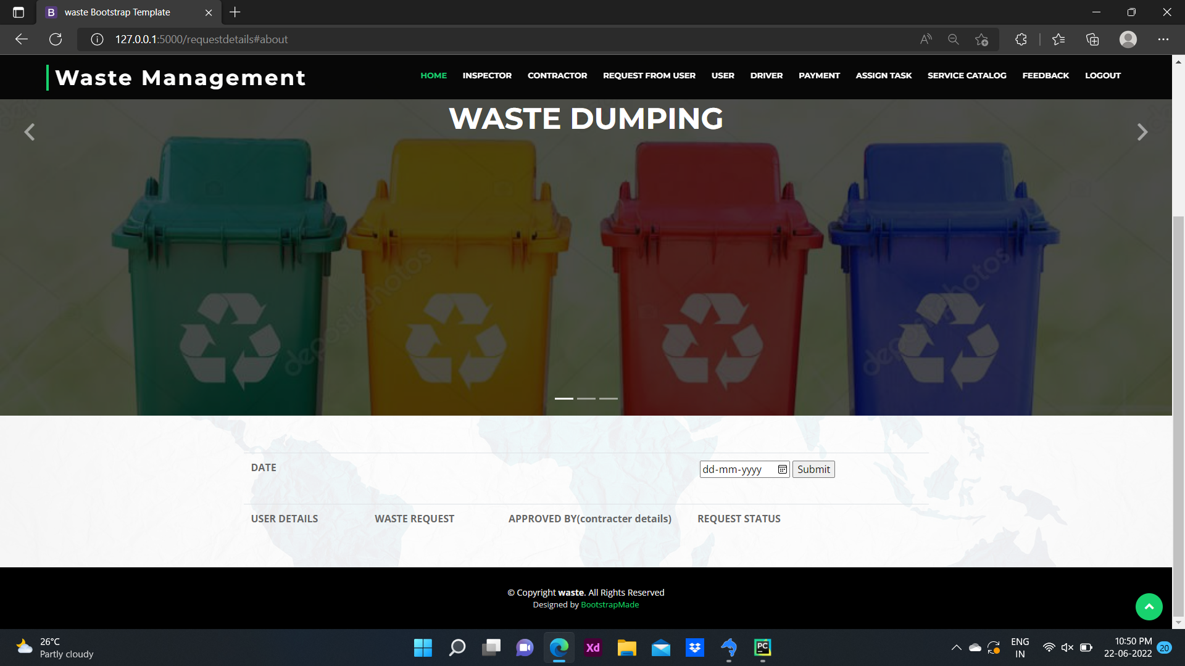

Slide 17
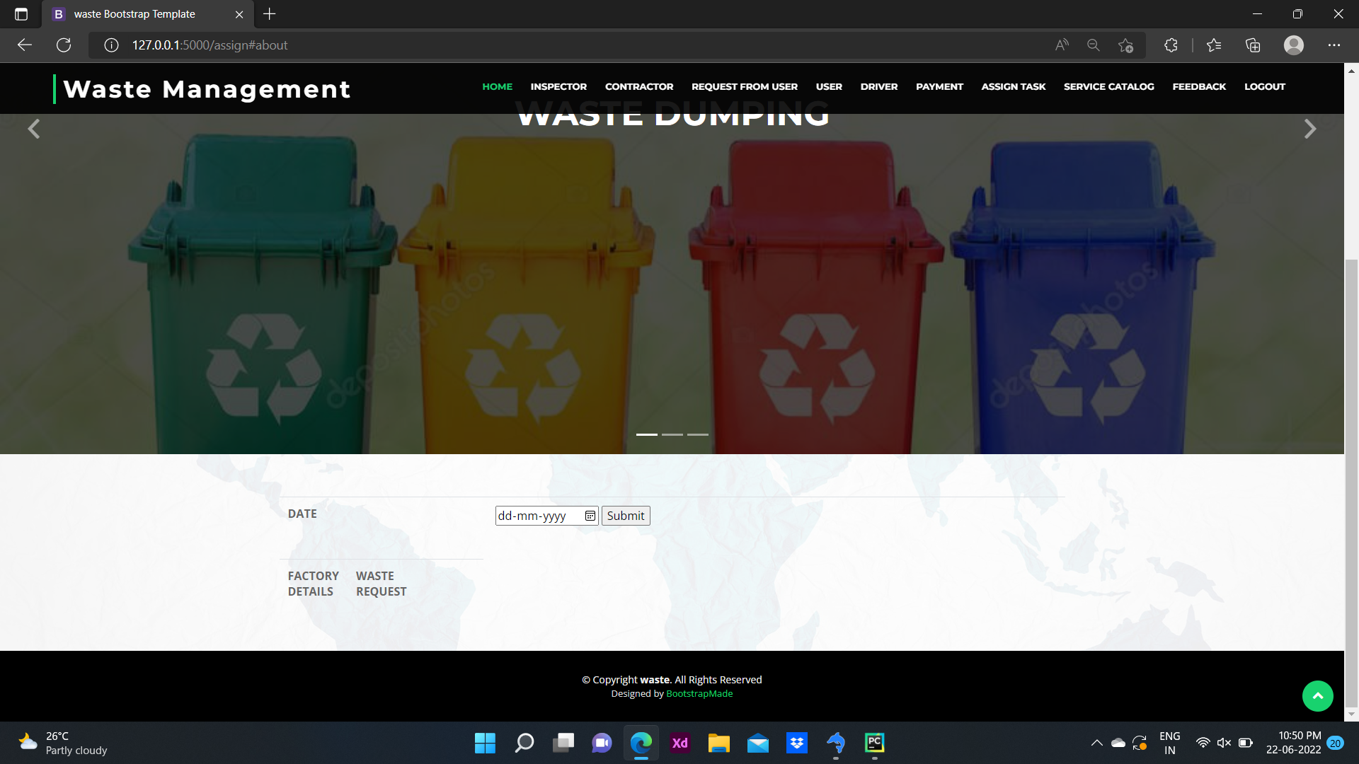

Slide 18
REFERENCES
[1] Adekunle, B. F. (2012). Management of Traditonal Markets in Ibadan, Nigeria: a focus on oja’ba and oje markets.
[2] Retrieved from http://www.regionalstudies.org/uploads/BALOGUN_Femi_Adekunle.pdf
[3] Aye, L., & Widjaya, E. R. (2006). Environmental and economic analyses of waste disposal options for
traditional markets in Indonesia. Waste Management, 26(10), 1180-1191.
[4] https:/doi.org/10.1016/j.wasman.2005.09.010
[5] Barros, A. I., Dekker, R., & Scholten, V. (1998). A two-level network for recycling sand: A case study.
[6] European Journal of Operational Research, 110(2), 199-214.
[7] https://doi.org/10.1016/S0377-2217(98)00093-9
[8] Basu, R. (2009). Solid Waste Management-A Model Study. Sies Journal of Management, 6, 20-24.

Slide 19
THANK YOU!

